Slide 1

Insert Update Delete

Slide 2
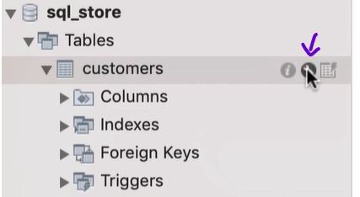
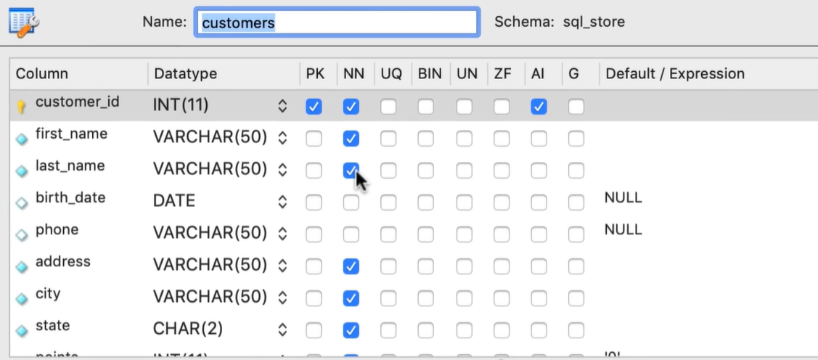
Table in design mode
INT = Number
VARCHAR = Variable
character
AI column => auto increment, we can see that customer_id have AI enabled NN column => not null PK column => primary key
Some of the values have a default values that we can use via using DEFAULT as value.

Slide 3
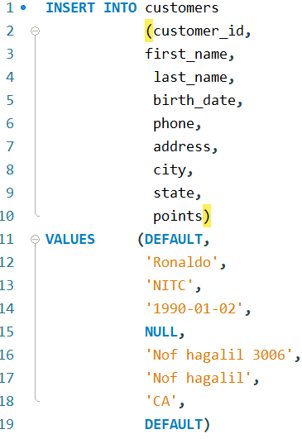
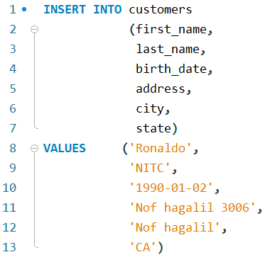
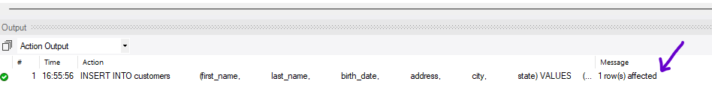
Insert value
DEFAULT: will generate default value for the ID, will let the database to assign a new value.
Because we don’t insert anything in the DEFAULT and NULL values we can remove them
The order of the column name not mater
After we run the script we can see a message that 1 row affected

Slide 4
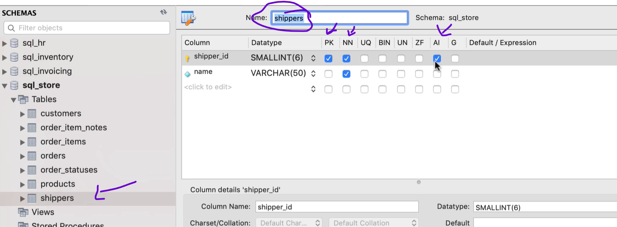
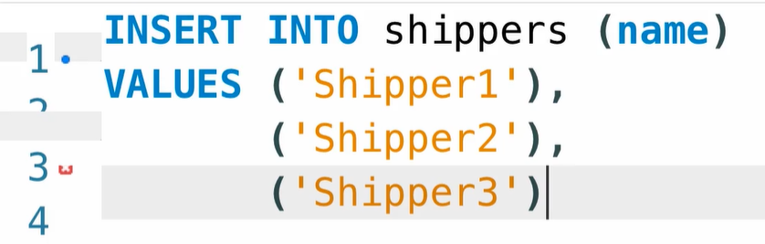
Inserting Multiple Rows
Using comma we can
insert multiple values

Slide 5
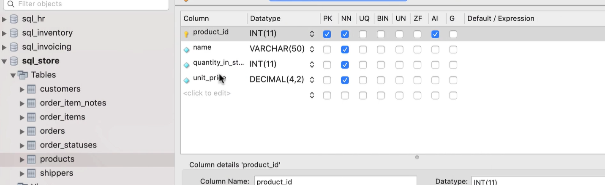
Exercise
Insert three rows in the products table

Slide 6
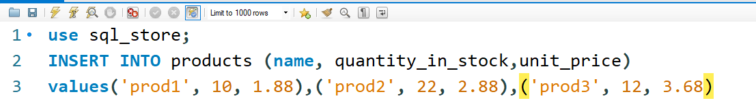
Solution

Slide 7
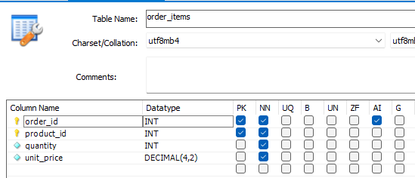
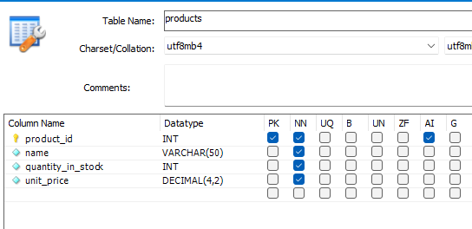
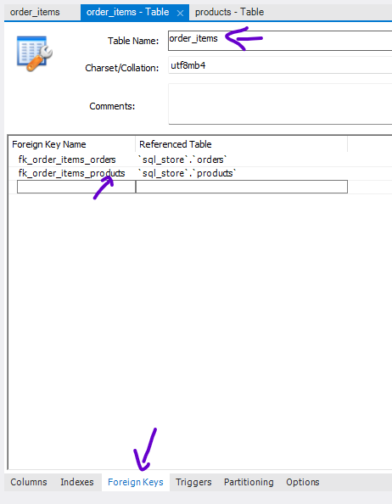
Inserting Hierarchical Rows
Products is a parent table
Order_items is a child table

Slide 8
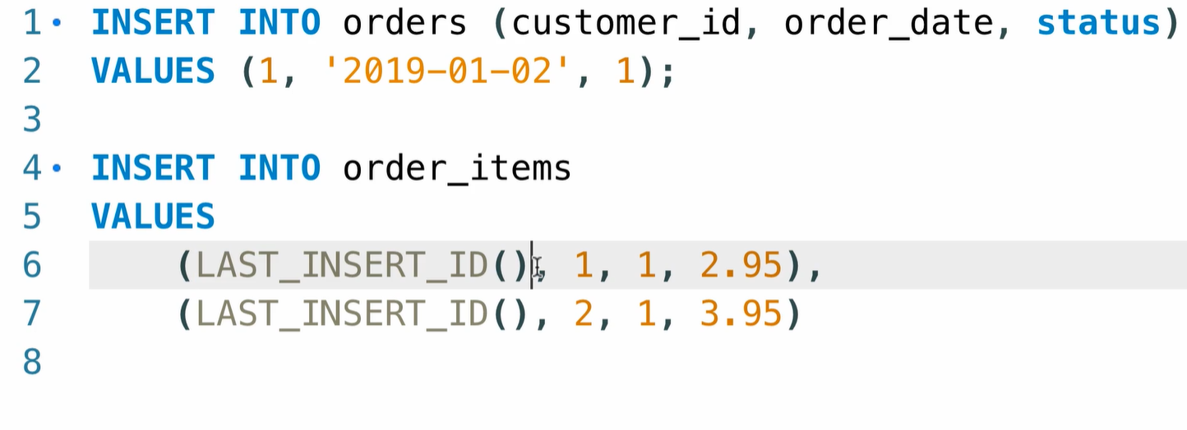
Inserting Hierarchical Rows
As soon as we insert an order, MYSQL is going to generate an ID for our new order. Now we need to be to access that id in order to insert the items in this table. MYSQL have a bunch of build in functions one of this function LAST_INSERT_ID

Slide 9
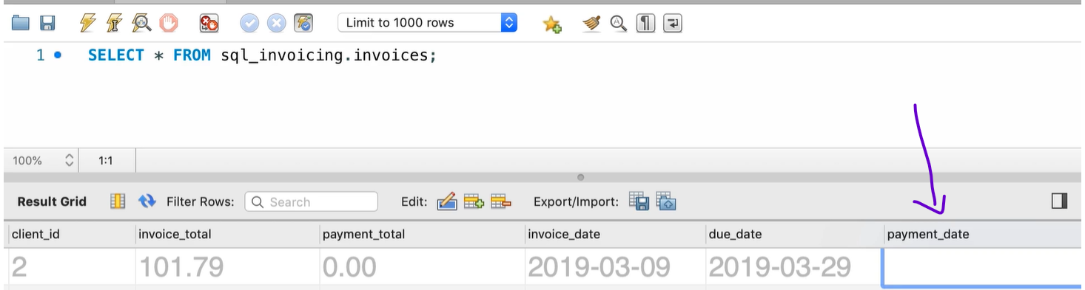
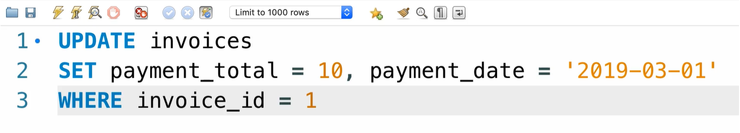
Update

Slide 10
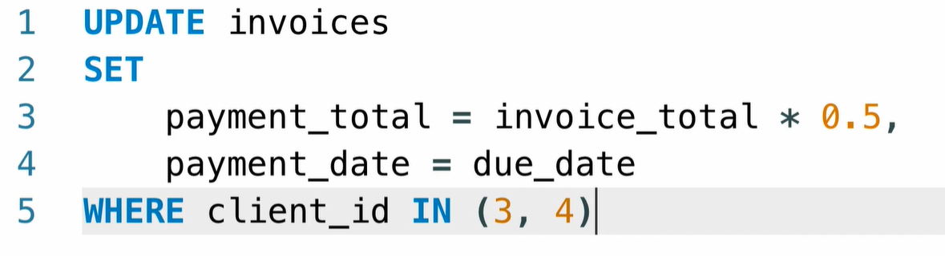
Updating Multiple Rows

Slide 11
Exercise
Write a SQL statement to -- give any customers born before 1990
-- 50 extra points

Slide 12
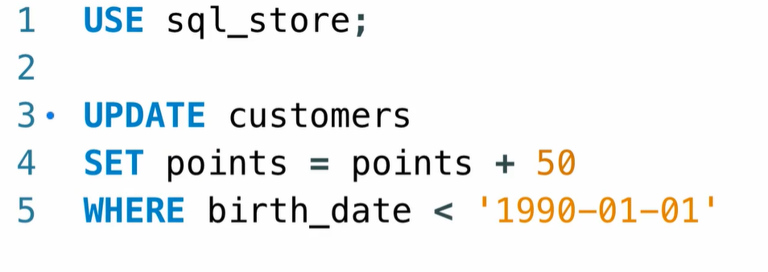
Solution

Slide 13
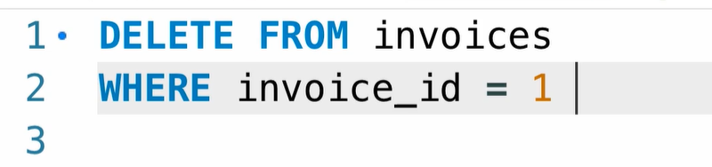
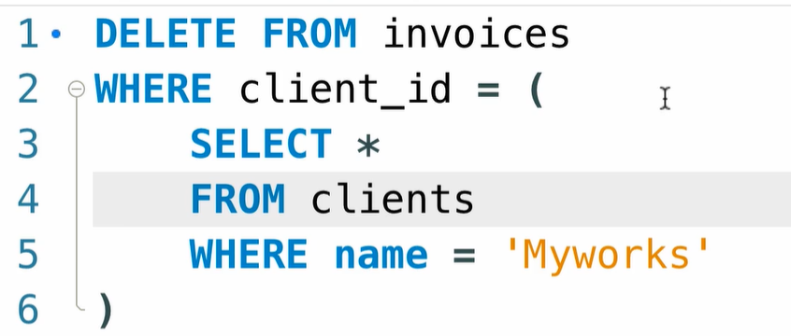
Delete Data from table

